Slide 1
POLS0008
INTRODUCTION TO QUANTITATIVE RESEARCH METHODS
EXAMINING DATA (PART II)
Dr Anwar Musah (a.musah@ucl.ac.uk)
Lecturer in Social and Geographic Data Science
UCL Geography
1
Notes:
Welcome to week two's lecture – examining data (part 2).
To this point, we only touched on graphs like the barplot, piechart and boxplot. In this session we will identify and explore the different techniques for data visualisation and looking at variable distributions in the context of summary statistics, here, we will go in-depth with histograms.

Slide 2
QUICK RECAP OF WEEK 2
2
Notes:
But before we start, let’s do a quick recap on stuff we learnt last

Slide 3
Summary measures
What kinds of analysis and summary statistics can you perform on a particular type of dataset?
1. Categorical Data
2. Numerical Data
You can group the data by according to categories and perform the following:
Compute the Frequencies (counts)
Compute the Percentages (or Relative Frequency)
Calculate the Cumulative Frequencies or Cumulative Percentages
Graphical approaches also include bar plots and pie charts
The Mode (category with that occurs most)
You can perform the following analysis:
Compute the mode (value that occur most)
Compute the median
Compute the mean
Lowest (Minimum) & Highest (Maximum)
Percentiles
Variance
Standard deviation
Range
Quartiles and Interquartile ranges
3

Slide 4
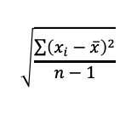

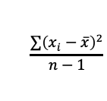
Calculation of these summary measures
Summary measure | Type | Formula
Mean | Central Tendency
Median | Central Tendency
Lower Quartile (25%) | Range value
Upper Quartile (75%) | Range value
Interquartile Range | Derived range value from Q1 & Q3
Range | Derived range value from min and max
Variance | Dispersion measure
Standard Deviation | Derived dispersion measure from variance
$$\overline{x}= \frac{\sum{x_{i}}}{n}$$
$$\frac{n+1}{2}$$
$$\frac{n+1}{4}$$
$$\frac{3(n+1)}{4}$$
$$\frac{\sum{{\left(x_{i}−\overline{x}\right)}^{2}}}{n−1}$$
$$\sqrt{\frac{\sum{{\left(x_{i}−\overline{x}\right)}^{2}}}{n−1}}$$
4

Slide 5
Data Visualisation
5

Slide 6
What is data visualisation?
Data visualisation gives us a clear idea of what information means by giving it context through maps, infographics, statistical charts and many more
Data visualisation makes quantitative (or qualitative) data more natural for the human mind to comprehend through pictorial means
Data visualisation makes it easier to identify trends, patterns and outliers within large data sets
6

Slide 7
Why is it important?
It’s a rapid and efficient approach for summarising raw data in the most efficient way
The most important thing is communication – it uses simplified visuals of raw data that’s “crunched” by models to communicate findings that are intuitive & effective
Visual outputs can serve help academics, stakeholders, policy makers etc., for decision making as well as prediction for outcomes.
7

Slide 8
Benefits of data visualisation?
To support evidence-based research in establishing correlations in relationships
To demonstrate trends of time which, turn in, is used for making predictions (aka forecast) ahead in time
To show the distribution or frequency of events represented in pictorial form, and how data is centred around a value and how its spread out around that value as well as over an interval etc.
IMPORTANT NOTE: The third bullet uses very useful visualisation techniques to display how data are distributed
8

Slide 9
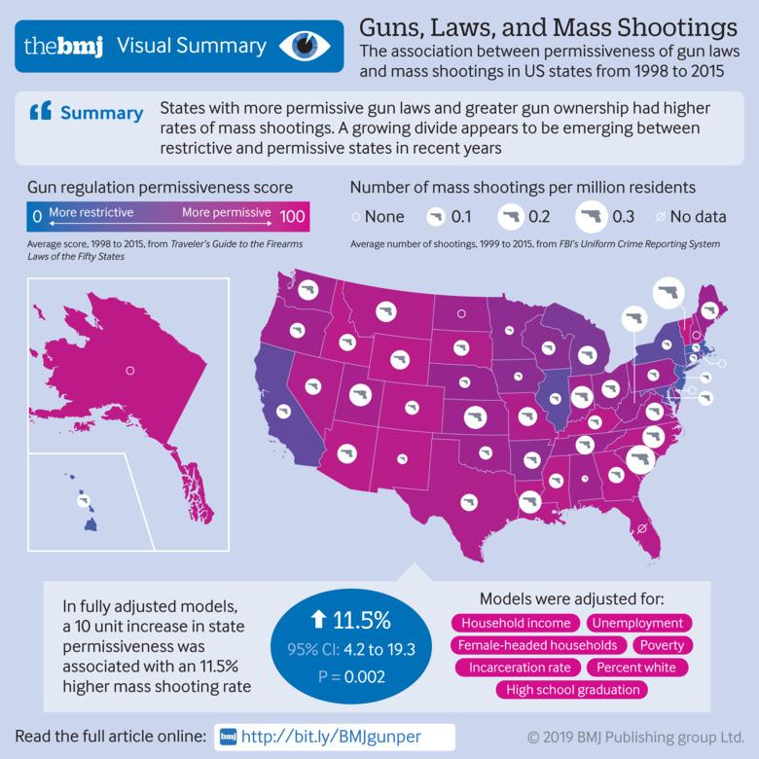
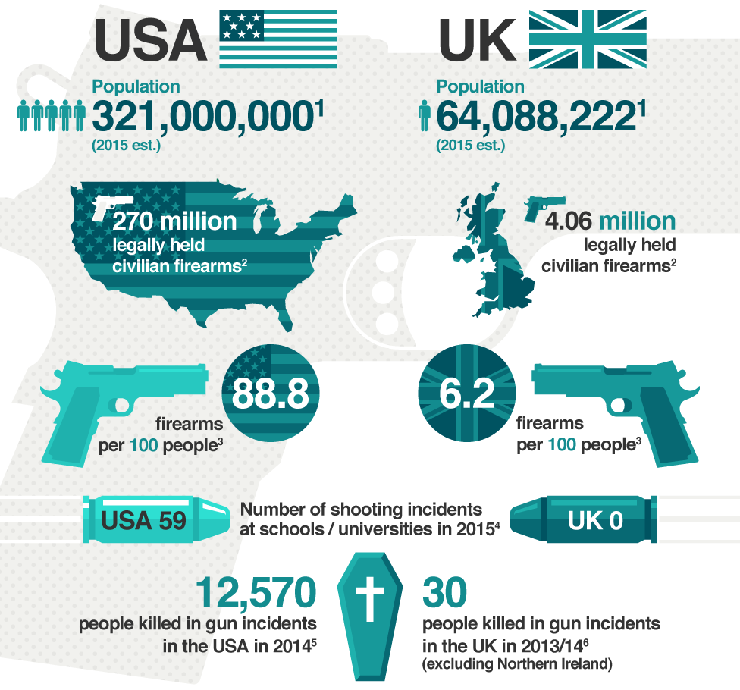
General techniques for data visualisation [1]
Infographics
1.
2.
9
Notes:
An infographic is a collection of imagery, which brings together all forms of charts (i.e., maps, pictograms, bar graphs statistical findings etc.) to present the overall findings. It usually has minimal text that gives an easy-to-understand overview of a topic.
An example of this is…

Slide 10
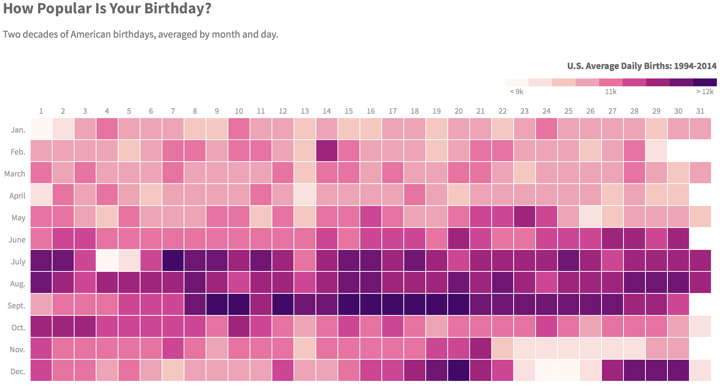
General techniques for data visualisation [2]
Heatmap visualisation
10
Source: https://thedailyviz.com/2016/09/17/how-common-is-your-birthday-dailyviz/

Slide 11
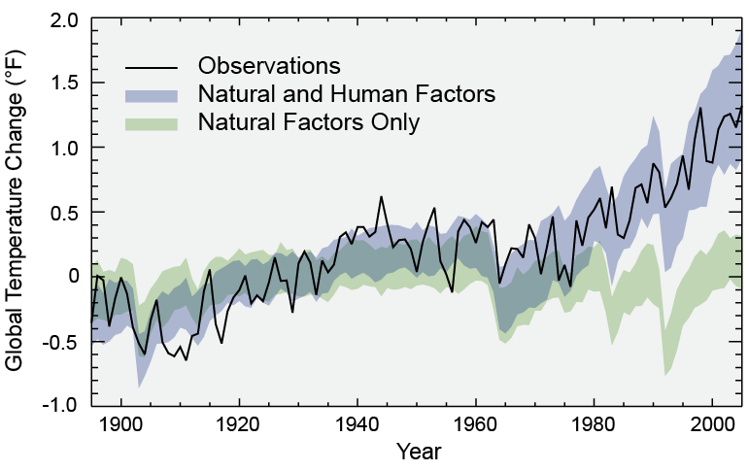
General techniques for data visualisation [3]
Trend-based visualisation
11

Slide 12
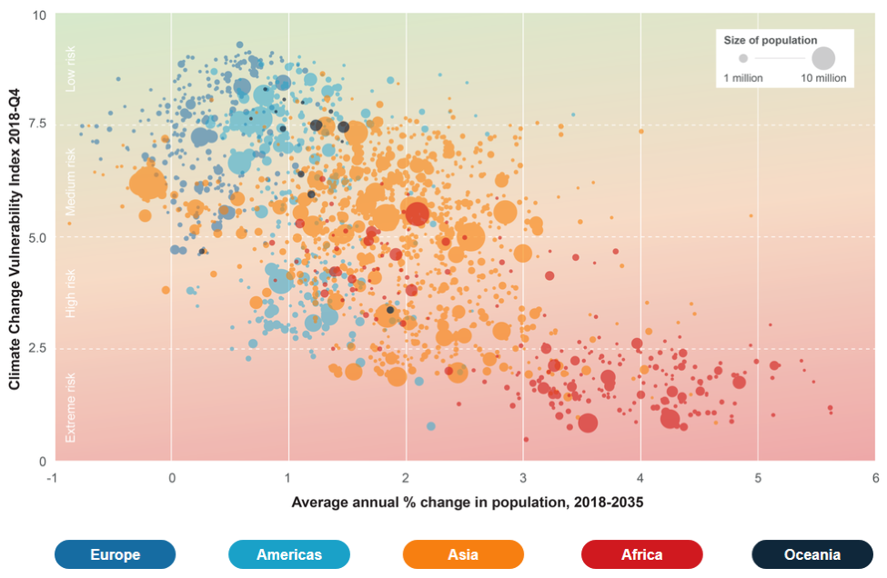
General techniques for data visualisation [4]
Bi-, or multi-variable visualisation
Source: LINK
12
Notes:
Scatterplot explores the relationship between population growth and climate change

Slide 13
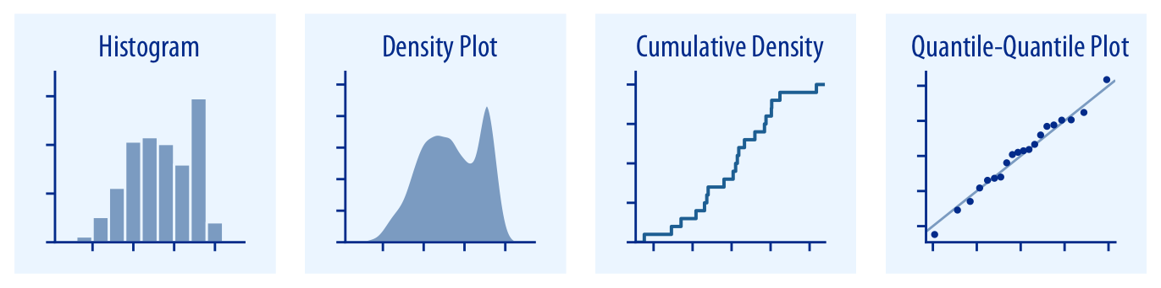
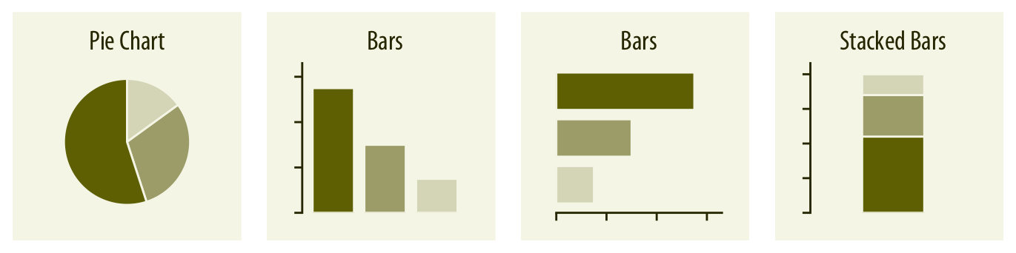
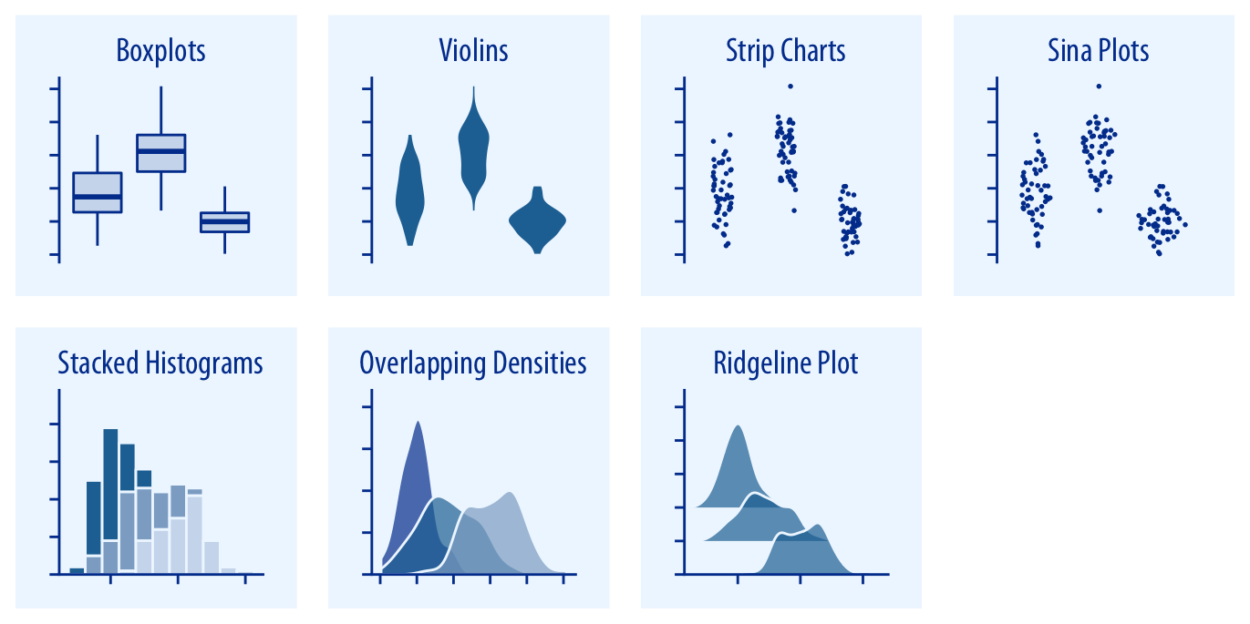
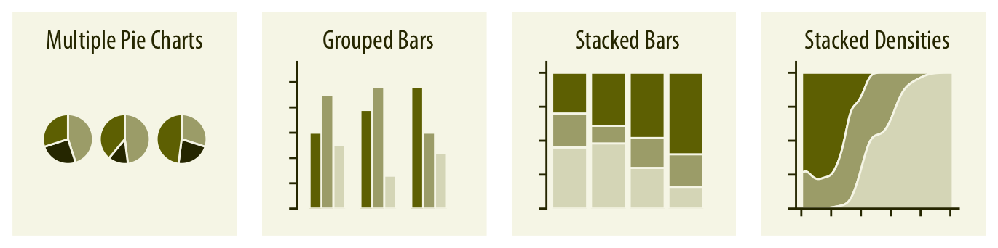
General techniques for data visualisation [5]
Visualisations representing densities & distributions of numerical data
1. Plots for densities and distributions (numerical data)
2. Plots for proportions (qualitative or categorical data)
Single variable
Multiple variables
Source: Fundamentals of Data Visualization [LINK]
13

Slide 14
Graphical representation of distributions
Histograms and/or Density plots are BEST for this type of visualization of numeric data
Histogram is the most commonly used graph to show the frequency of observations (or data points)
These observations (or data points) are counted in user specified ranges (aka groups) called “bins”
This bins are stacked adjacently to each other along the x-axis to visualise the frequency distribution which read from the y-axis.
Don’t confuse this with a bar plot!
14

Slide 15
Graphical representation of distributions
Example: Monitoring a new born puppy’s growth within the 1st 4-weeks. These are readings of the changes in its weight (kg)
Step 1: Data set: -0.2,-0.4, 0, 0.1, 0.1, 0.3, 0.12, 0.4, 0.5, 0.8, 0.9, 0.5, 0.6, 0.7, 0.6, 1.3, -0.2, 0, 0.1, 0.1, 0.3, 0.4, 0.5, 0.5, 0.6, 1.2
Data set (sorted): -0.40, -0.20, -0.20, 0.00, 0.00, 0.10, 0.10, 0.10, 0.10, 0.12, 0.30, 0.30, 0.40, 0.40, 0.50, 0.50, 0.50, 0.50, 0.60, 0.60, 0.60, 0.70, 0.80, 0.90, 1.20, 1.30
Step 2: Create set of user-specified ranges (or bins) to group the values along the x-axis
Bins are based on interval of 0.25 starting from -0.5 to 1.5 (-0.5. -0.25, 0, 0.25, 0.5, 0.75, 1, 1.25 and 1.5)
Step 3: Count the observed values that fall within each of its corresponding interval and plot as a histogram
15

Slide 16
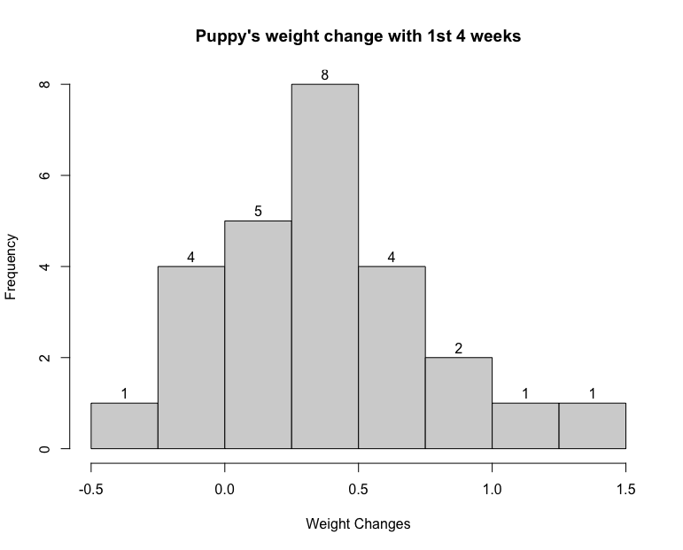
Graphical representation of distributions
Example: Monitoring a puppy’s growth within the 1st 4-weeks. These are readings of the changes in its weight (kg)
Step 1: Data set: -0.2,-0.4, 0, 0.1, 0.1, 0.3, 0.12, 0.4, 0.5, 0.8, 0.9, 0.5, 0.6, 0.7, 0.6, 1.3, -0.2, 0, 0.1, 0.1, 0.3, 0.4, 0.5, 0.5, 0.6, 1.2
Data set (sorted): -0.40, -0.20, -0.20, 0.00, 0.00, 0.10, 0.10, 0.10, 0.10, 0.12, 0.30, 0.30, 0.40, 0.40, 0.50, 0.50, 0.50, 0.50, 0.60, 0.60, 0.60, 0.70, 0.80, 0.90, 1.20, 1.30
Step 2: Create set of user-specified ranges (or bins) to group the values along the x-axis
Bins are based on interval of 0.25 starting from -0.5 to 1.5 (-0.5. -0.25, 0, 0.25, 0.5, 0.75, 1, 1.25 and 1.5)
Step 3: Count the observed values that fall within each of its corresponding interval and plot as a histogram
Code:
weightChanges <- c(-0.2,-0.4, 0, 0.1, 0.1, 0.3, 0.12, 0.4, 0.5, 0.8, 0.9, 0.5, 0.6, 0.7, 0.6, 1.3, -0.2, 0, 0.1, 0.1, 0.3, 0.4, 0.5, 0.5, 0.6, 1.2)
bins <- c(-0.5, -0.25, 0, 0.25, 0.5, 0.75, 1.0, 1.25, 1.5)
hist(weightChanges, breaks = bins, main="Puppy's weight change with 1st 4 weeks", xlab = "Weight Changes", labels = TRUE)
16

Slide 17
Graphical representation of distributions
Histograms and/or Density plots are BEST for this type of visualization of numeric data
Density plots shows the same thing as a histogram i.e., frequency of observations (or data points)
However, these observations (or data points) are counted on a continuous interval
Basically, it’s a smoothed curve, and because its plotted over on a continuous scale, we read the density as a proportion or percentage instead of counts.
17

Slide 18
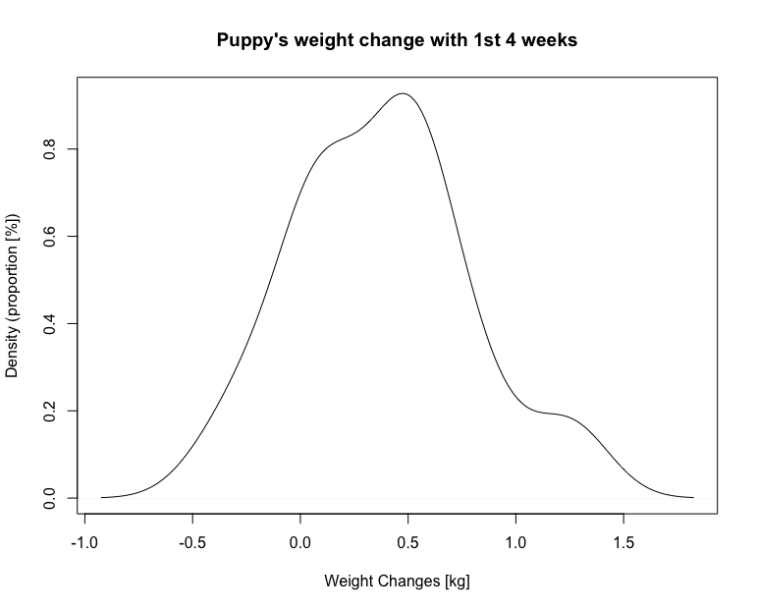
Graphical representation of distributions
Example: Monitoring a puppy’s growth within the 1st 4-weeks. These are readings of the changes in its weight (kg)
Step 1: Data set: -0.2,-0.4, 0, 0.1, 0.1, 0.3, 0.12, 0.4, 0.5, 0.8, 0.9, 0.5, 0.6, 0.7, 0.6, 1.3, -0.2, 0, 0.1, 0.1, 0.3, 0.4, 0.5, 0.5, 0.6, 1.2
Data set (sorted): -0.40, -0.20, -0.20, 0.00, 0.00, 0.10, 0.10, 0.10, 0.10, 0.12, 0.30, 0.30, 0.40, 0.40, 0.50, 0.50, 0.50, 0.50, 0.60, 0.60, 0.60, 0.70, 0.80, 0.90, 1.20, 1.30
Step 2: To create a density plot is quite easy!
Code:
weightChanges <- c(-0.2,-0.4, 0, 0.1, 0.1, 0.3, 0.12, 0.4, 0.5, 0.8, 0.9, 0.5, 0.6, 0.7, 0.6, 1.3, -0.2, 0, 0.1, 0.1, 0.3, 0.4, 0.5, 0.5, 0.6, 1.2)
den <- density(weightChanges)
plot(den, main="Puppy's weight change with 1st 4 weeks", xlab = "Weight Changes [kg]", ylab = "Density (proportion [%])")
18

Slide 19
Histogram/Density plots for assessing the distributions of data [1]
How does this link with summary statistics learnt from week 2?
19

Slide 20
Histogram/Density plots for assessing the distributions of data [2]
It’s a nice way to visually understand the distribution of a continuous variable. It gives you a feel for its central tendency and variability.
20

Slide 21
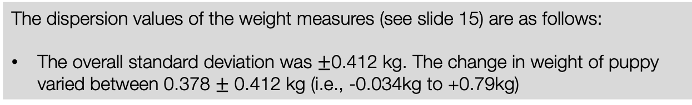
Histogram/Density plots for assessing the distributions of data [3]
The central tendencies of the weight measures (see slide 15) are as follows:
The overall mean weight change was 0.378 kg which means on average within that 8-week period, the puppy’s weight increased by 0.378 kg
The median weight change was 0.4 kg
The dispersion values of the weight measures (see slide 15) are as follows:
The overall standard deviation was $±$0.412 kg. The change in weight of puppy varied between 0.378 $±$ 0.412 kg (i.e., -0.034kg to +0.79kg)
IMPORTANT: Notice how the mean and median lay at the centre of the histogram or density plot.
Also, notice how the shape of the histogram is near symmetric.
This pattern is what we called a “Normal distribution” or “Bell-shaped curved”
21

Slide 22
Histogram/Density plots for assessing the distributions of data [4]
The central tendencies of the weight measures (see slide 15) are as follows:
The overall mean weight change was 0.378 kg which means on average within that 8-week period, the puppy’s weight increased by 0.378 kg
The median weight change was 0.4 kg
The dispersion values of the weight measures (see slide 15) are as follows:
The overall standard deviation was $±$0.412 kg. The change in weight of puppy varied between 0.378 $±$ 0.412 kg (i.e., -0.034kg to +0.79kg)
IMPORTANT: Notice how the mean and median lay at the centre of the histogram or density plot.
Also, notice how the shape of the histogram is near symmetric.
This pattern is what we called a “Normal distribution” or “Bell-shaped curved”
22

Slide 23
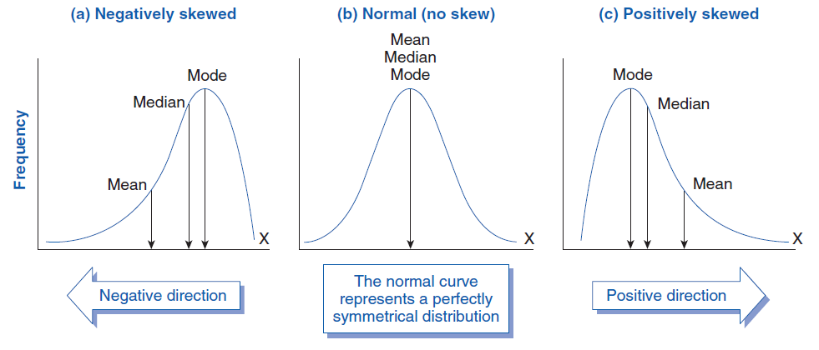
23

Slide 24
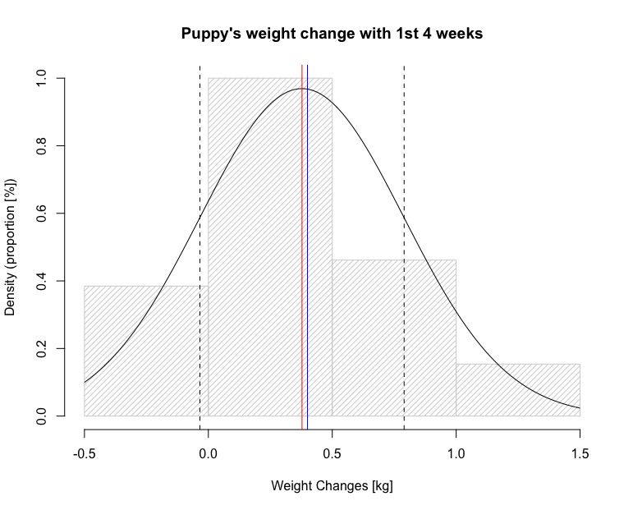
R Code:
# enter data
weightChanges <- c(-0.2,-0.4, 0, 0.1, 0.1, 0.3, 0.12, 0.4, 0.5, 0.8, 0.9, 0.5, 0.6, 0.7, 0.6, 1.3, -0.2, 0, 0.1, 0.1, 0.3, 0.4, 0.5, 0.5, 0.6, 1.2)
# next, extract mean and standard deviation from data
m<-mean(weightChanges)
std<-sd(weightChanges)
# plot histogram with normal curve
hist(weightChanges, density = 20, prob=TRUE, main="Puppy's weight change with 1st 4 weeks", xlab = "Weight Changes [kg]", ylab = "Density (proportion [%])")
# adds the normal curve
curve(dnorm(x, mean=m, sd=std), add=TRUE)
# add red line for mean
abline(v = 0.378, col = "red")
# add blue line for median
abline(v = 0.400, col = "blue")
# add black dashed line for -sd
abline(v = -0.034, lty = "dashed", col = "black")
# add black dashed line for +sd
abline(v = 0.79, lty = "dashed", col = "black")
24

Slide 25
Visualisation in RStudio
Creating impressive visualisation
Base functions for creating graphics in R: plot( )
R Packages for creating impressive plots: ggplot2( )
You will have to first install ‘ggplot2’ package first with the install.package( ) function
After its installed, you will need to load the package into R with library( ) function
All this will be become clear in the practical session
25

Slide 26

Breaktime
26

Slide 27
Visualisation: Types of graphs & scenarios
27
Notes:
This section is to reinforce the “when to use” a particular graph and its scenario – and what pitfalls to avoid!

Slide 28
Graph types for data visualisation
1. Plots for densities and distributions (numerical data)
2. Plots for proportions (qualitative or categorical data)
Single variable
Multiple variables
Source: Fundamentals of Data Visualization [LINK]
28

Slide 29
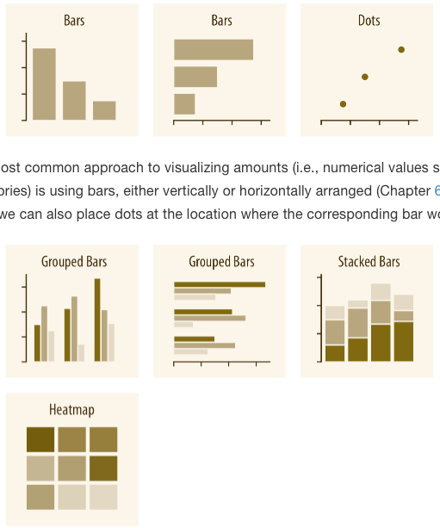
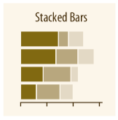
Visualisation of data with amounts & categories [1]
A single variable with a set of categories
The most commonest approach to visualising data the corresponds to amounts (i.e., numerical values [or proportions]) for some of categories in a categorical variable is the use of bars.
Alternatively, the bars can removed and replace with dot at the location where the corresponding bar would end.
Single variable
(W/categories)
Multiple variables each with a set of categories
If there are two or more sets of categories for which we want to show amounts, we can group or stack the bars. However, we can also map the categories onto the x and y axis and show amounts by colour, via a heatmap.
Multiple variables
(W/categories)
Personal thoughts (especially when dealing with singular variables with categories):
In a nominal case – the ranking i.e., categories high to low (and vice versa) matters in the visualisation
In an ordinal case – the order of the categories matters in the visualisation
Let’s see examples and potential pitfalls!
29

Slide 30
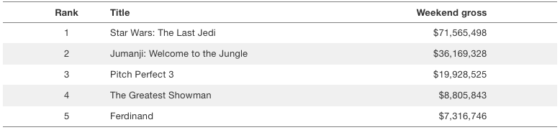
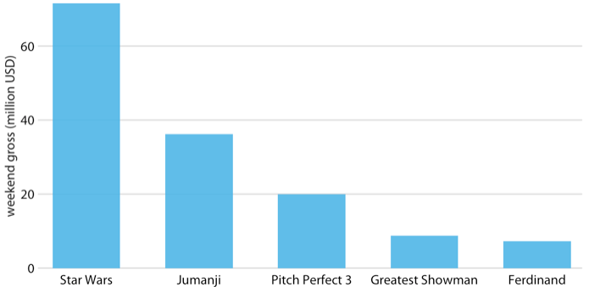
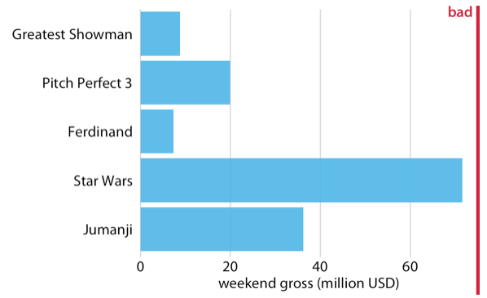
Visualisation of data with amounts & categories [2]
The table below contains movies with the weekend grossing values (Source: http://www.boxofficemojo.com/)
Notes: Remember in a nominal case - the ranking i.e., categories from high to low (or vice versa) matters in the visualisation
Good
Bad
30

Slide 31
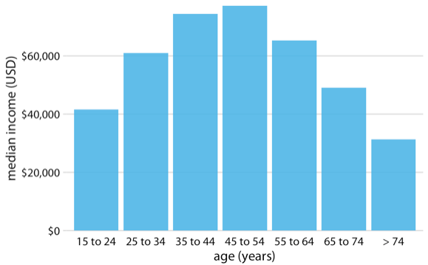
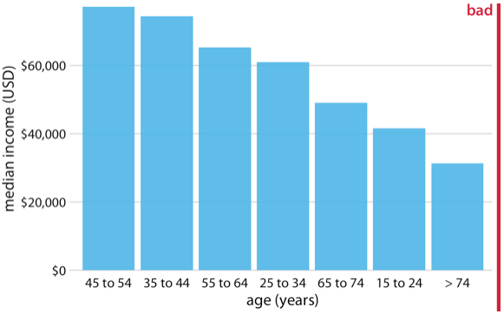
Visualisation of data with amounts & categories [3]
The graphed data represents 2016 median U.S. annual household income versus age group
Good
Bad
Notes: Remember in an ordinal case - the ordering of the categories matters in the visualisation
31

Slide 32
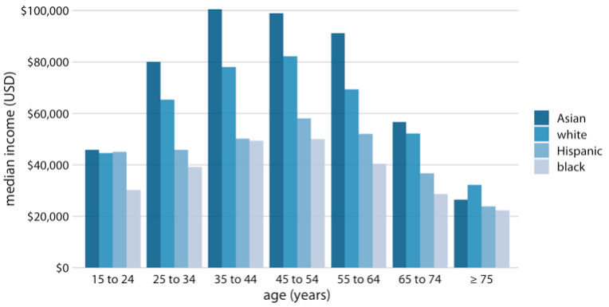
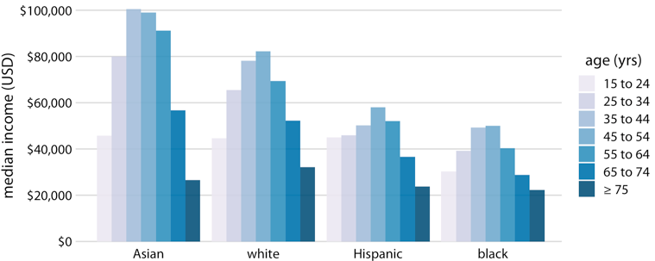
Visualisation of data with amounts & categories [4]
This is an example of a grouped bar plot. Where the outcome variable [income (in USD)] is visualised across two other independent categorical variables:
Age group (years) [ordered]
Ethnicity [nominal]
Top graph: Main variables of interest in this case is income versus age groups (which the age groups are broken down by ethnicity). Ordering in the age groups are maintained here on the x-axis.
Bottom graph: Main variables of interest in this case is income versus Ethnicity groups (which the ethnic groups are broken down by age). Ordering in the ethnic categories on the x-axis is not a issue here - but the ordering of the age groups within ethnic categories must be maintained here on the x-axis.
32

Slide 33
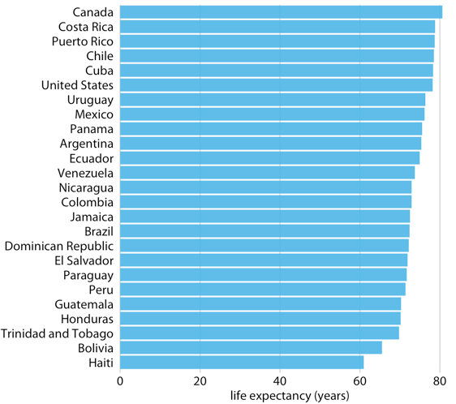
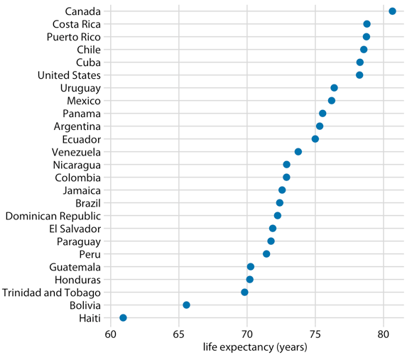
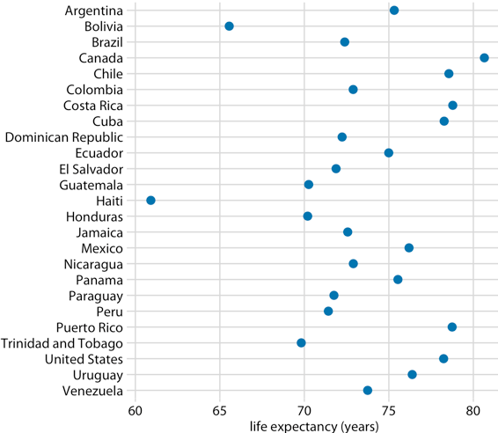
Visualisation of data with amounts & categories [5]
Dot Plots: An alternate version to the bars are dot plots. The bar can removed and replace with dot at the location where the corresponding bar would end.
The three images at the bottom represents data on life expectancies of countries in Central and South America in 2007 [Data source: Gapminder project]
QUIZ: Which graph is correct – LEFT, MIDDLE OR RIGHT one?
33

Slide 34
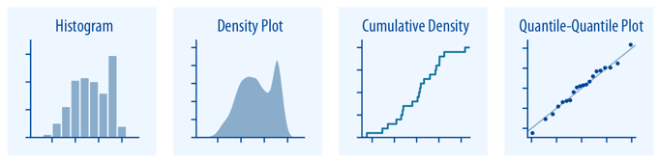
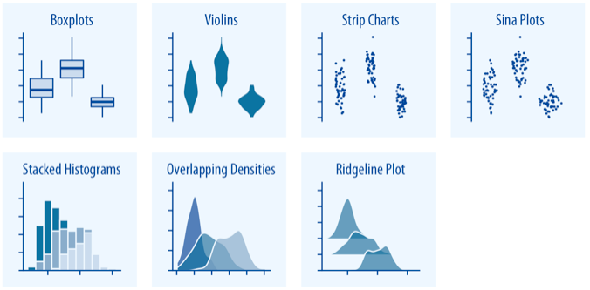
Visualisation of data concerning distributions
These visualisation methods are the most common approach to represent or display the frequency of observations, as well as how data is spread out over an interval, or how its grouped/clustered around a central point.
You can’t really go wrong here – your go-to choice for visualising continuous data for examining its distribution are:
Histogram
Density plot
Cumulative density plots
Box plots
Quantile-Quantile plot (used in regression… a lot!)
34

Slide 35
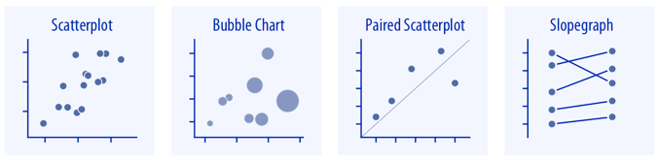
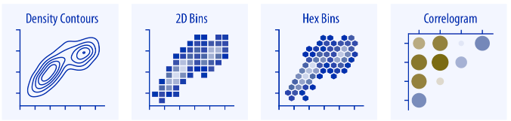
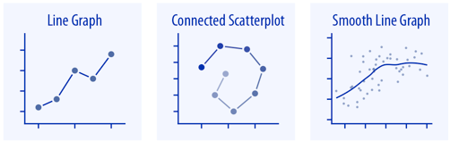
Visualisation of data concerning x-y relationships [1]
These visualisation methods are the most common approach to represent the relationship between one continuous variable to another. The y-axis is always the dependent variable, and the x-axis is always the independent variable where we assess its effect or impact on the dependent variable!
No never make this mistake of flipping the positions - as this will be considered as a critical error
Your go-to choice for visualising two continuous data for examining its relations are:
Scatter plot (correlation & regression)
Line graph (time series [outcome versus time]])
Smooth line graph (non-linear regression)
Correlogram (correlations between multiple pairs of variables.
35

Slide 36
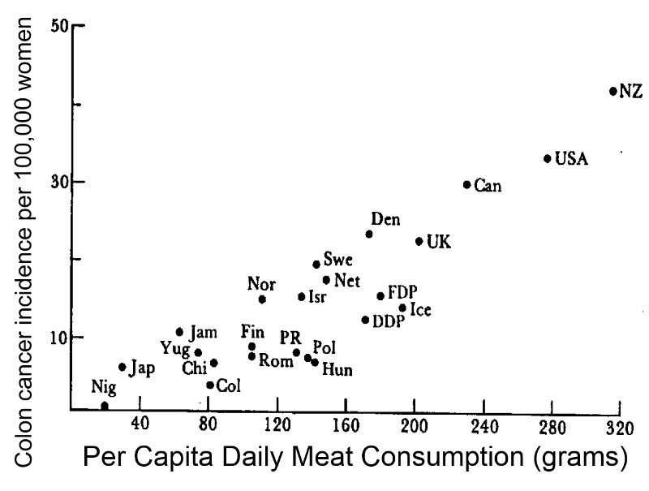
Visualisation of data concerning x-y relationships [2]
Assessing the relationship between meat consumption and colon cancer, a country-level analysis
Don’t worry – you’ll be taught correlations soon.
This is an example to show its use on scatter plots
R code:
cor.test(df$xvar, df$yvar)
Example output:
cor.test(cancerdata$meatcon, cancerdata$incidence)
OUTPUT:
Pearson's product-moment correlation
data: cancerdata$meatcon and cancerdata$incidence
df = 2, p-value = 0.0015
95 percent confidence interval:
0.6451325 0.9963561
sample estimates:
Cor
0.8315218
Interpretation: There is a very strong positive correlation between levels of meat consumption and incidence of colon cancer in general, and such relationship is statistically significant (p = 0.0015 < 0.05)
36

Slide 37
Best practices & advice when it comes to data visualisation [1]
Everything on your graph should be labelled accordingly:
Title – a clear short title letting the reader know what they are looking at should be present. Or alternatively, a figure legend for that image will do.
Axis labels/titles – clear labels for the x and y axes must be present
Should include in the labelling the units of measurements [height (m), soil arsenic (mg/kg) etc.]
These labels should be short and descriptive
Legends – for categories in categorical variables which keys/colour codes must be present and labelled accordingly
Male and Female, and not 0 and 1.
Captions – If the graphics are NOT yours (i.e., its ripped from a source). Take the opportunity to apply a caption on the graph (on or beneath it) providing source attribution for the data.
Colour scheme – Use of colour scheme matters
Sequential colours – for plotting quantitative variable that goes from low to high (vice versa)
Diverging – for contrasting the extremes (low, medium and high) of a quantitative variable
Qualitative – e.g., nominal categories. Use to distinguish between different categories in a categorical variable
37

Slide 38
Best practices & advice when it comes to data visualisation [2]
The x and y axis are labelled with the current units of measurements (i.e., years and USD)
Legend for ethnic, which is labelled accordingly has been provided, and colour coded too.
A title was not given but a figure legend was added at the base of the image.
Example of very good visualisation
Ethnicity
Figure 1: Descriptive analysis shows the overall median income among various age groups broken down ethnic categories in the United States of America.
38

Slide 39
Live demonstration time – Cleaning and Plotting in R
39

Slide 40

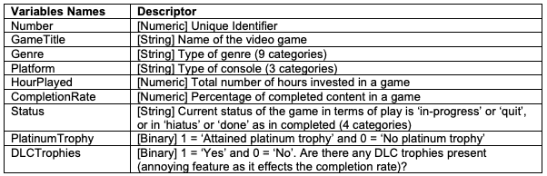
A Video gamer’s statistics
We have compiled the following information about the gaming habits of Anwar Musah (aka The-PhD-Gamer) across 3 console generations i.e., PlayStation 3, 4 and 5.
There are 161 game titles (~6,000 hours of game time) listed in the shared dataset.
PSNProfiles (https://psnprofiles.com/)
Data Descriptor: Downloadable Dataset
Let’s perform some data management on this dataset and generate some graphs with the base R plot() function, and with the Tidyverse ggplot2() function as well to show the two worlds of coding in RStudio.
40

Slide 41
Any questions?
41

